Slide 1
My First Quarto Presentation
Jiayu Ban

Slide 2
Introduction
Welcome to Quarto Presentations!
In this presentation, we’ll learn how to:
Write documents in Markdown
Add code chunks and results
Generate dynamic presentations

Slide 3
What is Quarto?
Quarto allows you to mix text, code, and outputs in a single document.
It supports multiple output formats, including:
HTML webpages
PDF reports
Microsoft Word
PowerPoint presentations
Reveal.js slides

Slide 4
Markdown Basics
Markdown uses simple symbols for formatting:
text → italics
text → bold
# → headings
or - → bullet points
1. → numbered lists

Slide 5
Example: Lists and subitems
Item 1
Item 2
Subitem A
Subitem B

Slide 6
Using Python Code in Quarto
Let’s demonstrate how we can mix text and Python code in one presentation.

Slide 7
Example 1: Generate Random Data
count 1000.000000 mean 0.047670 std 0.993422 min -3.241267 25% -0.622810 50% 0.045124 75% 0.681907 max 3.078881 dtype: float64

Slide 8
 | Year | Revenue
0 | 2020 | 120
1 | 2021 | 150
2 | 2022 | 180
3 | 2023 | 210
4 | 2024 | 260
Example 2: Show a Simple Table

Slide 9
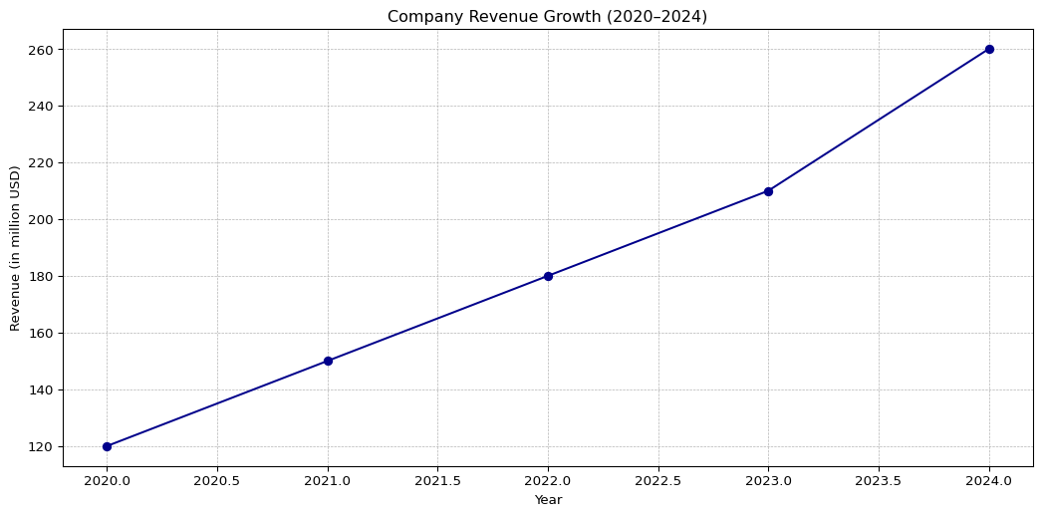
Example 3: Plot with Matplotlib

Slide 10
 | Date | Price
257 | 2024-12-25 | 150.007615
258 | 2024-12-26 | 150.012053
259 | 2024-12-27 | 150.019800
260 | 2024-12-30 | 150.010530
261 | 2024-12-31 | 150.009935
Example 4: Simulated Financial Data

Slide 11
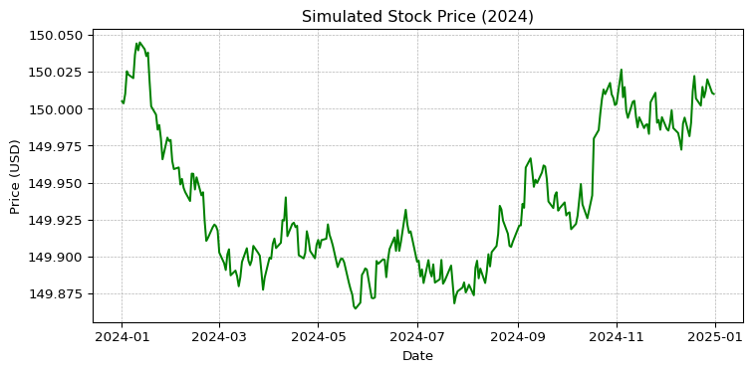
Example 5: Plot Simulated Prices

Slide 12
Inline Results Example
You can display computed values directly in text.
On {python} latest_date, the simulated stock closed at {python} latest_price USD.

Slide 13
Math Example
You can also include formulas using LaTeX syntax:
$y_{t}=α_{0}+ϕ_{1}x_{t}+ϵ_{t}$

Slide 14
Summary
In this presentation, we learned how to:
Write Markdown text
Embed Python code
Create plots and tables
Generate dynamic presentations in PowerPoint and HTML

